Slide 1
Repairing Disengagement
Jan Hendrik Dithmar (Supervisor: Erica Melis)
Based on the paper
“Repairing Disengagement With Non-Invasive Interventions”
by Ivon Arroyo et al. (2007)
Notes:
Paper:
Repairing Disengagement With Non-Invasive Interventions
Ivon ARROYO et al. (2007)

Slide 2
Motivation
We have
Students using a tutoring system
Decrease in motivation (= disengagement)
We want to
Detect disengagement
Adapt to disengaged behavior by providing “something useful”
→ Machine learning

Slide 3
Machine learning with data
Adapt to new circumstances automatically
Learn engagement state
Dynamically react on current engagement
How to learn the engagement state?
Collect data (→ Data acquisition)
Process data (predict engagement state by using special techniques to “calculate” the engagement state)

Slide 4
The experiment
SAT
MCAS
Control Group
88 students
Tutor Control Group
Interventions Group
2 mathematics tests of 43 items
Interventions:
Performance Graph
Tip
Tutoring System “Wayang Outpost”
Notes:
Wayang means “shadow puppet” and is a multimedia tutoring system for geometry.
In the paper is no information about how things are logged in Wayang.
SAT (Scholastic Aptitude Test) = test at the end of high school in the US
MCAS = high stakes, statewide-standardized achievement test exam
Only the “math-part” was taken into account. Tests usually contain also other fields.
DON’T TALK ABOUT ASSIGNMENTS TO GROUPS! SLIDES ARE LATER!

Slide 5
The experiment
SAT
MCAS
Control Group
88 students
Tutor Control Group
Interventions Group
2 mathematics tests of 43 items
Interventions:
Performance Graph
Tip
Tutoring System “Wayang Outpost”
Notes:
SAT (Scholastic Aptitude Test) = test at the end of high school in the US
MCAS = high stakes, statewide-standardized achievement test exam
Only the “math-part” was taken into account. Tests usually contain also other fields.

Slide 6
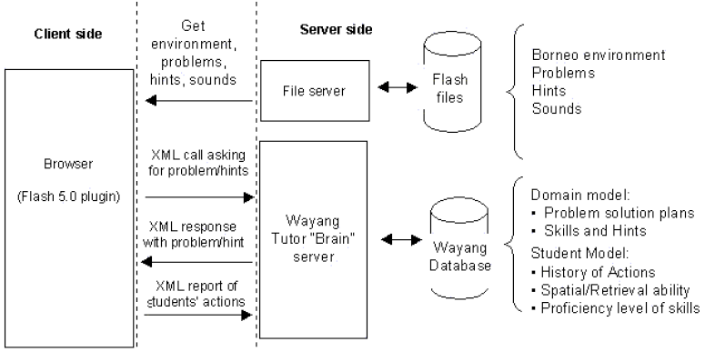
Wayang Outpost Architecture
Source: I. Arroyo et al. “Wayang Outpost: Intelligent Tutoring for High Stakes Achievement Tests”
Notes:
Logging goes in a centralized database.
Tutor is Java-based. Interaction between them is solved via XML calls.
Wayang Tutor “Brain” server: database-backed Java servlet

Slide 7
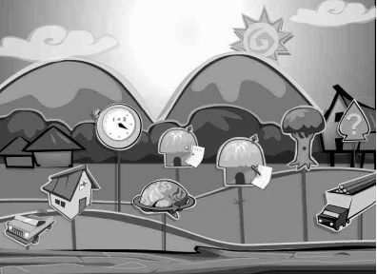
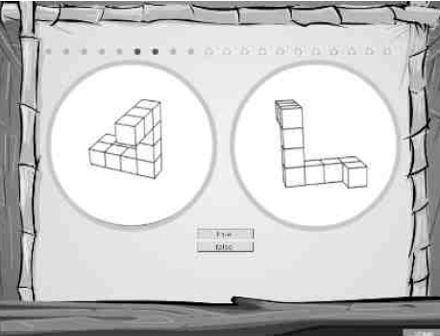
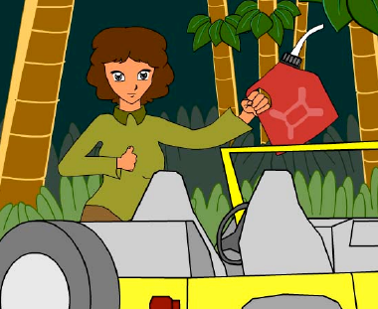
Wayang Outpost Interface
Source: I. Arroyo et al. “Wayang Outpost: Intelligent Tutoring for High Stakes Achievement Tests”
Notes:
Top left: The Wayang Village showing buttons for different student modules, including the SAT hut, adventures, spatial skills test and the math fact retrieval test
Top right: Assessing the student’s spatial abilities through a standard mental rotation test.
Bottom left: Anne Russon leads the student to save orangutans. “We need to find the shortest route and estimate how much extra gas we should take”. This is the fantasy component.

Slide 8
Data acquisition
Students after logon pseudo-randomly assigned to
Tutor Control Group
Traditional Wayang: Possibility to click on help button which provides multimedia hints
Experimental (Interventions) Group
Receiving intervention screens at fixed intervals of 6 problems
Notes:
Type of intervention randomly-made decision: Performance graph OR tip (and which one)

Slide 9
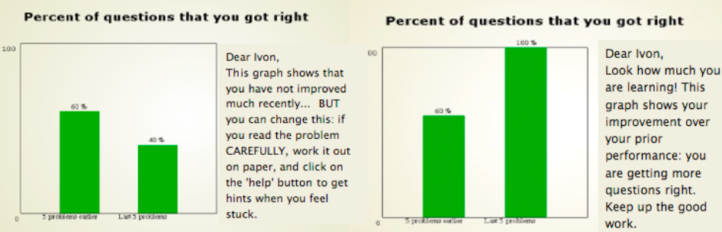
Performance Graphs
5 problems
earlier
Last 5 problems
5 problems
earlier
Last 5 problems
Notes:
Performance Graphs (Progress Charts) that show students their accuracy of responses from before to recently
DISADVANTAGE at the moment: very simple, possibly inaccurate

Slide 10
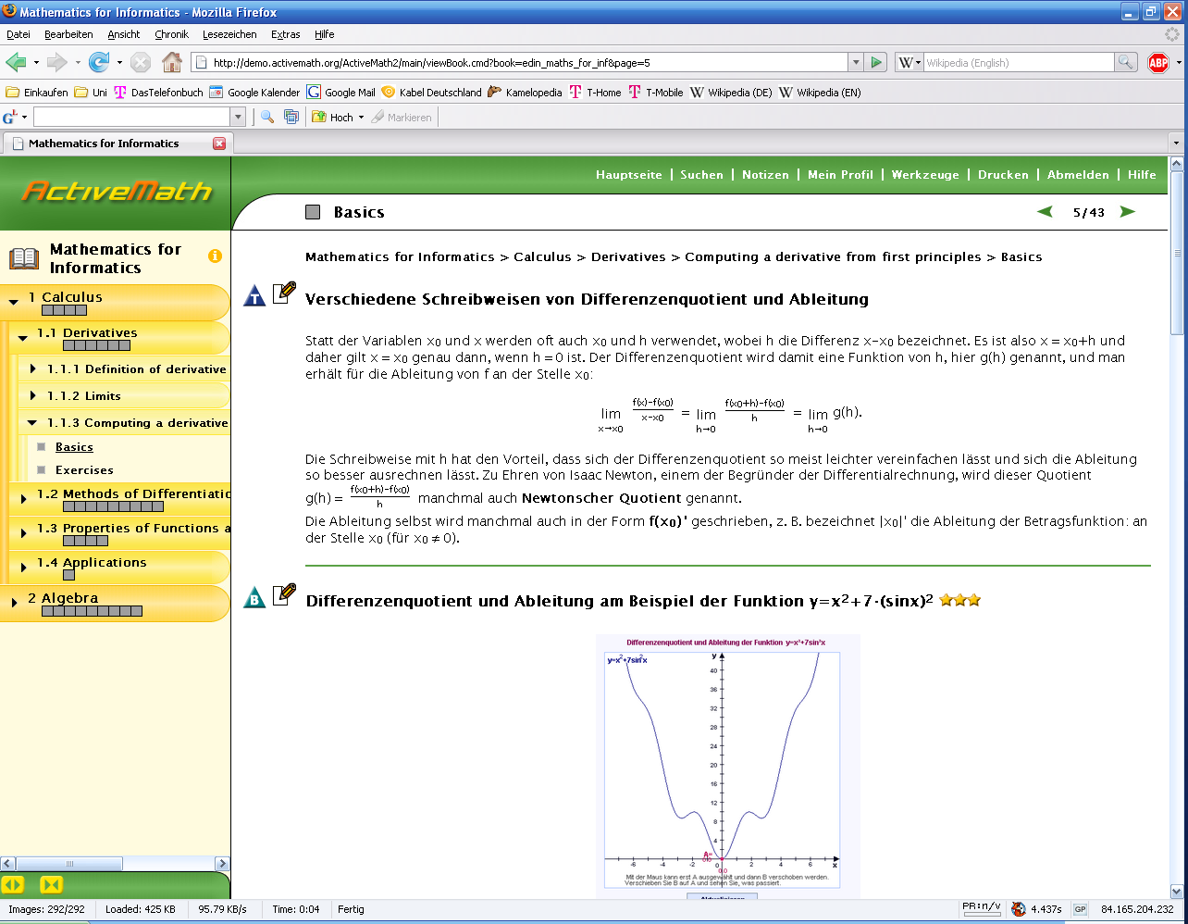
“Performance Graphs” in AM
Number of exercises counts
Notes:
PRO of this design: One can get overview of own knowledge; whole progress is depicted.
CONTRA of this design: Do not see actual performance in previous tasks.

Slide 11
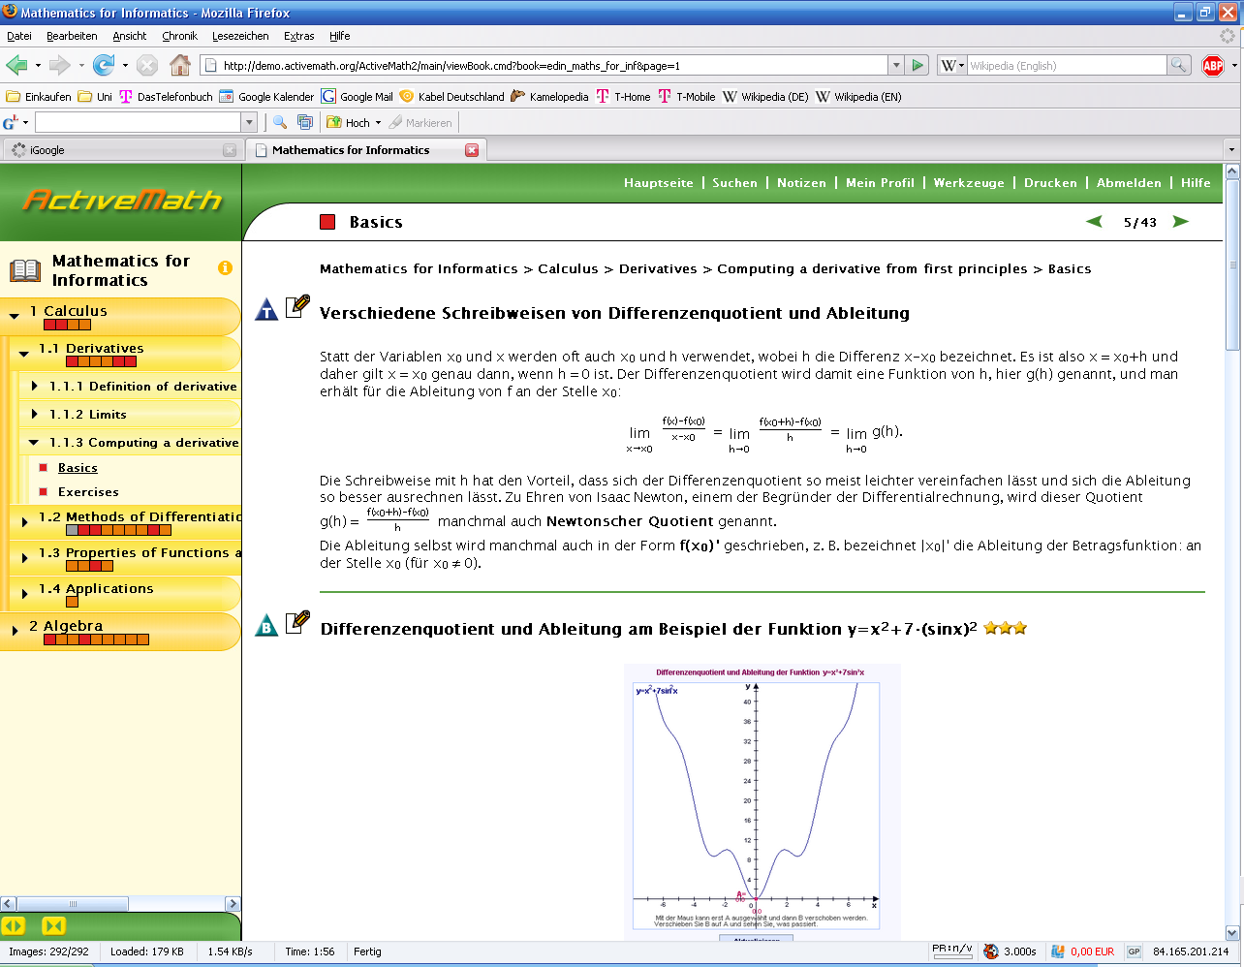
“Performance Graphs” in AM

Slide 12
Tips
Tip-read-carefully
Slow down
Read problem carefully
Read provided hints carefully
Tip-make-guess
Think about the problem
Make a guess
If guess is wrong, ask for hints
Notes:
Of course, in this setting the students were not been able to use this tip already because they didn’t had the possibility to click the help button.

Slide 13
Tips
Suggest a productive learning behavior
Tip-read-carefully
Slow down, read problem carefully, read provided hints carefully
Tip-make-guess
Think about the problem, make a guess, if guess is wrong then ask for hints
Notes:
Of course, in this setting the students were not been able to use this tip already because they didn’t had the possibility to click the help button.

Slide 14
Data acquisition (2)
Teach the two groups differently
4 test days
Now we want to analyze this data…
43 items extracted from SAT and MCAS
Pretest
Tutoring
Posttest
43 items extracted from SAT and MCAS
day #1
day #2
day #3
day #4
Notes:
Pretest: online test in mathematics
Posttest: online test in mathematics
Tutoring: teaching of mathematical concepts

Slide 15
Data analysis
Do interventions help (at all)?
What type of interventions help?
Whom do interventions help?
How can you predict whether an intervention helps at a certain point?
Notes:
You could also ask “When do interventions help?” which was actually not answered in this paper. The authors want to do it “in the near term”

Slide 16
AN(C)OVA
ANOVA (analysis of variance)
Collection of statistical models
ANCOVA (analysis of covariance)
Find dependencies between two (ore more) variables
significant difference at p<0.05
Notes:
Both models assume that the dependent variable is normally distributed.
ANOVA: Observed variance is partitioned into components due to different explanatory variables.
ANCOVA: Merger of ANOVA and regression for continuous variables.
In statistics, regression analysis is a technique which examines the relation of a dependent variable (response variable) to specified independent variables (explanatory variables).
p: probability of error

Slide 17
Results
Group | Math Pretest | Math Posttest | MCAS Passing Rate
No Tutor
Tutor Control
Tutor Intervention
Group | Math Pretest | Math Posttest | MCAS Passing Rate
No Tutor |  |  | 76%
Tutor Control | 40% (20) | 40% (28) | 79%
Tutor Intervention | 33% (19) | 42% (22) | 92%
Survey question item | Tutor Interventions | Tutor Control
“The Wayang Tutor is friendly”
“The Wayang Tutor is smart”
Learning Orientation (average over 2 items)
Did you learn how to tackle math problems by using the Wayang system?
Helpfulness of the help (avg over 3 items)
Survey question item | Tutor Interventions | Tutor Control
“The Wayang Tutor is friendly” | 4.8 (1.0) | 3.9 (1.4)
“The Wayang Tutor is smart” | 5.1 (1.0) | 4.3 (1.3)
Learning Orientation (average over 2 items) | 0.60 (0.8) | 0.39 (0.6)
Did you learn how to tackle math problems by using the Wayang system? | 3.5 (0.74) | 3.1 (0.82)
Helpfulness of the help (avg over 3 items) | 4.2 (0.73) | 3.8 (0.90)
Notes:
Table 1: Means and standard deviations in performance measures before and after tutoring
Table 1 shows a “between-subjects” analysis, which means that the groups are compared with respect to each other.
Table 2: Means and standard deviations for responses to post-tutor surveys
Learning orientation scores in two items measure performance vs. learning orientation.
No significant differences for questions like ‘the tutor is concerned about my learning’ or self-efficacy
ANCOVA used to analyze the difference between the learning gains between the two groups

Slide 18
Data analysis: step 1 Do interventions help (at all)?
Notes:
Shows a “between-subjects” analysis, which means that the groups are compared with respect to each other.
ANCOVA used to analyze the difference between the learning gains between the two groups. Dependent variable was posttest score (percent correct), group as independent variable and pretest as a covariate.
Test of between subjects indicated a significant difference in posttest score between the tutor-control and tutor-interventions groups (F=4.23, p=0.04), suggesting that there is a significant difference in learning gains favoring the interventions-enhanced tutor group.

Slide 19
Data analysis: step 1 Do interventions help (at all)?
Notes:
Shows a “between-subjects” analysis, which means that the groups are compared with respect to each other.
ANCOVA used to analyze the difference between the learning gains between the two groups. Dependent variable was posttest score (percent correct), group as independent variable and pretest as a covariate.
Test of between subjects indicated a significant difference in posttest score between the tutor-control and tutor-interventions groups (F=4.23, p=0.04), suggesting that there is a significant difference in learning gains favoring the interventions-enhanced tutor group.

Slide 20
Post-tutor survey questions
Notes:
Y-axis: means for responses to post-tutor surveys
FORTH SURVEY QUESTION:
Did you learn how to tackle math problems by usings the Wayang system?

Slide 21
Data analysis When do interventions help?
Always?
Good overview possible, but annoying
What about engaged students?
After a fixed amount of problems?
Good overview possible, not very annoying
What about engaged students?
Adapted to the student’s engagement state?
Seems to be a good solution

Slide 22
Time as engagement-indicator?
Short time period per problem = Disengaged?
Students skip fast through the problems
Students request help very quickly to get an answer to a question (help abuse)
Student might be good
Long time period per problem = Engaged?
Student might be off-task
No investment of time results in no learning
Insufficient but also necessary condition to learning!
Notes:
Can the level of engagement only be classified by using the time spent on a problem?
Students become more disengaged as time progresses, if tutor only presents problems: So the time spent on a problem is not enough to define the level of engagement!
Long time period:
Necessary: if student doesn’t invest time on the problem, they will surely not learn
Insufficient: student might be off-task (off-task = doing something that is not related to the problem; in contrast: on-task)

Slide 23
Time as engagement-indicator?
It’s a problem!
Short time period per problem = Disengaged?
What about good and engaged students?
Long time period per problem = Engaged?
Insufficient but also necessary condition to learning!
Notes:
Can the level of engagement only be classified by using the time spent on a problem?
Students become more disengaged as time progresses, if tutor only presents problems: So the time spent on a problem is not enough to define the level of engagement!
Long time period:
Necessary: if student doesn’t invest time on the problem, they will surely not learn
Insufficient: student might be off-task (off-task = doing something that is not related to the problem; in contrast: on-task)

Slide 24
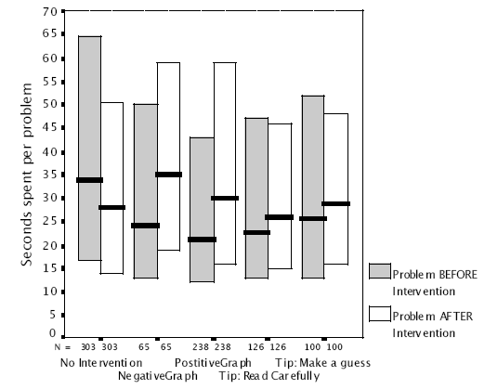
Data analysis: step 2 What type of interventions help?
Increase of median time spent in the problem after seeing an intervention.
Significant difference in time spent for Graphs, but not for Tips.
N: number of random pairs of subsequent problems
Notes:
Left 2 quartiles: tutor control
Other quartiles: intervention
Students tend to get more disengaged as the session progresses (median and quartiles are lower in the second problem, actually the median by 6 seconds) → point to the first two quartiles
Bigger difference in median with negative or positive graph (→ SHOW ANIMATION)
In the paper: There is a significant difference for time spent from the problem before to the problem after a Graph Intervention (p = 0.004), but not for before and after the tips (p = 0.49).
Can the level of engagement only be classified by using the time spent on a problem?
Students become more disengaged as time progresses, if tutor only presents problems: So the time spent on a problem is not enough to define the level of engagement!
Long time period:
Necessary: if student doesn’t invest time on the problem, they will surely not learn
Insufficient: student might be off-task (off-task = doing something that is not related to the problem; in contrast: on-task)

Slide 25
Data analysis: step 3 Whom do interventions help?
Help for disengaged students!
Problem: How to detect disengaged students?
Solution: Dynamic Mixture Model-IRT (based on Hidden Markov Models and Item Response Theory)
Notes:
“Help for disengaged students”: found out by experiment

Slide 26
Hidden Markov Models
0.7
0.3
0.6
Rainy
Sunny
0.6
0.4
0.4
0.5
0.6
0.1
0.4
0.3
0.1
P(clean | Rainy) = 0.5
P(clean | Sunny) = 0.1
walk
shop
clean
Adapted from: http://en.wikipedia.org/wiki/Hidden_markov_model
Notes:
Upper part: states with state transition probabilities
Lower part: possible observations with output probabilities
Assume you have a friend who lives far away and to whom you talk daily over the telephone about what he did that day. Your friend is only interested in three activities: walking in the park, shopping, and cleaning his apartment. The choice of what to do is determined exclusively by the weather on a given day. You have no definite information about the weather where your friend lives, but you know general trends. Based on what he tells you he did each day, you try to guess what the weather must have been like.
You believe that the weather operates as a discrete Markov chain. There are two states, "Rainy" and "Sunny", but you cannot observe them directly, that is, they are hidden from you. On each day, there is a certain chance that your friend will perform one of the following activities, depending on the weather: "walk", "shop", or "clean". Since your friend tells you about his activities, those are the observations. The entire system is that of a hidden Markov model (HMM).

Slide 27
Hidden Markov Models
0.7
0.3
0.6
Rainy
Sunny
0.6
0.4
0.4
0.5
0.6
0.1
0.4
0.3
0.1
P(clean | Rainy) = 0.5
P(clean | Sunny) = 0.1
walk
shop
clean
Adapted from: http://en.wikipedia.org/wiki/Hidden_markov_model
Notes:
Upper part: states with state transition probabilities
Lower part: possible observations with output probabilities
Assume you have a friend who lives far away and to whom you talk daily over the telephone about what he did that day. Your friend is only interested in three activities: walking in the park, shopping, and cleaning his apartment. The choice of what to do is determined exclusively by the weather on a given day. You have no definite information about the weather where your friend lives, but you know general trends. Based on what he tells you he did each day, you try to guess what the weather must have been like.
You believe that the weather operates as a discrete Markov chain. There are two states, "Rainy" and "Sunny", but you cannot observe them directly, that is, they are hidden from you. On each day, there is a certain chance that your friend will perform one of the following activities, depending on the weather: "walk", "shop", or "clean". Since your friend tells you about his activities, those are the observations. The entire system is that of a hidden Markov model (HMM).

Slide 28
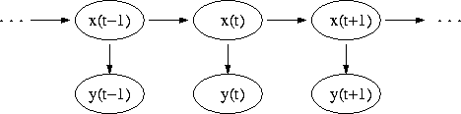
Additional concepts
Time in HMMs
Item Response Theory
Evaluate student’s proficiency
Facilitates computer adaptive testing
Examine test behavior at the problem level
x(t): hidden state at time t
y(t): observation at time t
Sources: http://en.wikipedia.org/wiki/Hidden_markov_model
http://work.psych.uiuc.edu/irt/intro_main.asp
Notes:
x(t) only depends on x(t-1)
y(t) only depends on x(t)
Arrows denote conditional dependencies
IRT: Allows to calculate conditional standard errors of measurement based on a test information function

Slide 29
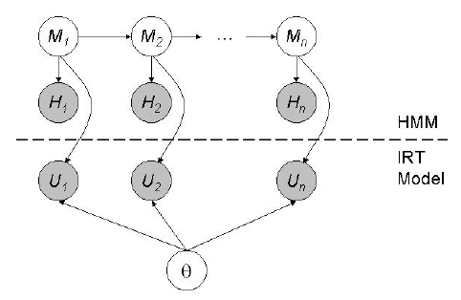
Data analysis
Dynamic Mixture Model-IRT (= IRT + HMM)
i: current problem
M_{i}: motivation
H_{i}: evidence of motivation
U_{i}: (initial) response of user
θ: proficiency
Source: J. Johns et al. “A Dynamic Mixture Model to Detect Student Motivation and Proficiency”
Notes:
Evidence (Anhaltspunkt) for motivation: there can be one component taken into account → Time as engagement-indicator
Poor performance can either be because of low motivation or insufficient ability
Item Response Theory:
Evaluate student’s proficiency
Facilitates computer adaptive testing

Slide 30
Data analysis: step 4 How can you predict whether an intervention helps at a certain point?
Dynamic Mixture Model-IRT (= IRT + HMM)
i: current problem
M_{i}: motivation
H_{i}: evidence of motivation
U_{i}: (initial) response of user
θ: proficiency
Source: J. Johns et al. “A Dynamic Mixture Model to Detect Student Motivation and Proficiency”
Notes:
Evidence (Anhaltspunkt) for motivation: there can be one component taken into account → Time as engagement-indicator
Poor performance can either be because of low motivation or insufficient ability
Item Response Theory:
Evaluate student’s proficiency
Facilitates computer adaptive testing

Slide 31
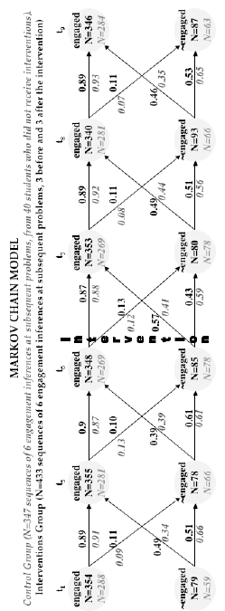
Engaged or not engaged, that is the question...
P(E_{t5}|~E_{t4}) = 0.49
N: number of students
Interventions help disengaged students!
Notes:
“Control Group” means here “Tutor Control Group”
The HMM infers the probability that a student is in any of the states ‘engaged’, ‘quick-guess’, ‘hint-abuse’ or ‘skipped-problem’ for each problem, depending on their behavior on the current problem and the motivation state in the previous time step. The student is classified as engaged/disengaged based on the engagement state of the highest likelihood.
Re-engagement probabilities are higher for the Interventions Group
Interventions only have a short-term impact on engagement.
Exposing students who are already engaged to an intervention might be unproductive.
WHICH DATA NEEDS TO BE LOGGED?
Log inferred engagement state to calculate transition probabilities, store transition probabilities afterwards

Slide 32
Is this model appropriate?
What was done?
Inference of the probability that a student is in a any of the states ‘engaged’, ‘quick-guess’, ‘hint-abuse’ or ‘skipped-problem’
Model to present and process collected data
Based on that: calculation of transition probabilities
What is missing in the Markov Chain?
Type of intervention (Performance Graph or Tip)
Notes:
The HMM infers the probability that a student is in any of the states ‘engaged’, ‘quick-guess’, ‘hint-abuse’ or ‘skipped-problem’ for each problem, depending on their behavior on the current problem and the motivation state in the previous time step. The student is classified as engaged/disengaged based on the engagement state of the highest likelihood.

Slide 33
Probability of a student being disengaged
 | t₄ | t₅ | t₆ |  | t₇ | t₈ | t₉
Interventions | 0.18 | 0.18 | 0.20 |  | 0.18 | 0.21 | 0.20
Control | 0.17 | 0.19 | 0.22 |  | 0.22 | 0.19 | 0.18
Difference | 0.01 | -0.01 | -0.02 |  | -0.04 | 0.02 | 0.02
Notes:
Probability of a student being disengaged. Hardly any difference in probabilities.

Slide 34
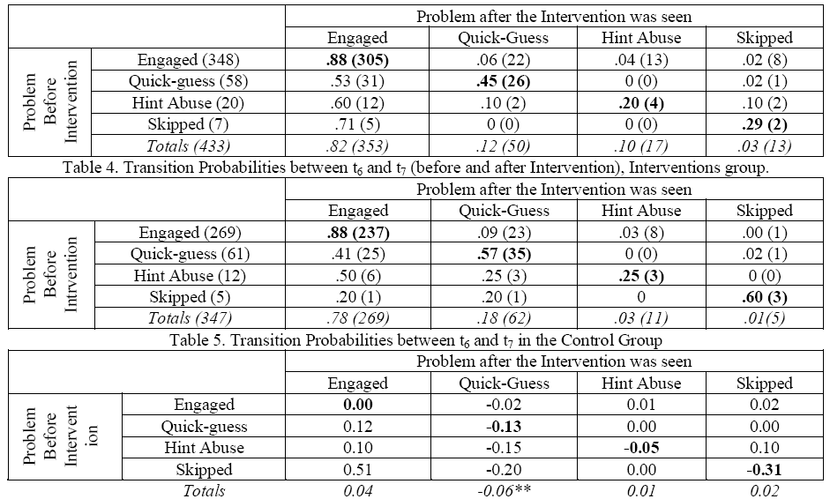
Notes:
Table 6: difference between the previous matrices. Positive values indicate that the probability is higher for the motivational group, negative values indicate the opposite.
Table 6 (bold diagonal) shows that students in the interventions group are less prone to stay in the same disengagement state.

Slide 35
Summary
The “winner”: Interventions group.

Slide 36
Summary
The “winner”: Interventions group. Why?
Lower pre-test scores, but higher post-test scores
Higher passing rates in standardized tests
Conclusion: Presented data mining helps to detect disengagement and react on it
How can we use such data mining in ActiveMath?

Slide 37
Summary
The “winner”: Interventions group. Why?
Lower pre-test scores, but higher post-test scores
Higher passing rates in standardized tests
Higher learning-orientation in post-tutor survey
Feeling, that tutor was more helpful, they learned more, they attributed more human-like characteristics to tutoring software
Higher chance becoming re-engaged after seeing an intervention
So what?

Slide 38
How to use such data mining in ActiveMath?
Present (non-invasive) interventions
based for example on Dynamic Mixture Model-IRT to predict engagement state (for which students?)
adapted to the user’s engagement state (which interventions? / when?)
maybe with additional information such as
feedback on planning how to solve a specific kind of problem
individual hints based on user’s profile
Notes:
Based on DMM-IRT: need to store the result out of that
Adapted to the user’s engagement state: need current engagement state, (next) inferred engagement state; take also into account earlier problems → need to store earlier engagement states

Slide 39
Conclusions
Non-invasive interventions
help students to reflect on their progress
Integration of an (intelligent) agent
Showing different gestures (being angry, being impressed) → special type of intervention, human-like attitude

Slide 40
Conclusions (2)
Provide individual hints
User’s profile as basis
New meta-cognitive feedback
Feedback on planning how to solve a specific kind of problem
Notes:
Easy example concerning “individual hints”: computer science people count beginning with 0 where mathematics people start with 1.

Slide 41
Thank you!

Slide 42
QUESTIONS?

Slide 43
References
I. Arroyo et al. “Repairing Disengagement With Non-Invasive Interventions” http://ccbit.cs.umass.edu/people/ivon/AIED2007.PDF (Original paper on which the talk is based on)
I. Arroyo et al. “Wayang Outpost: Intelligent Tutoring for High Stakes Achievement Tests” http://wayang.cs.umass.edu/wayang/Wayang-Final.pdf (Paper on the Tutoring System Wayang Outpost)
B. M. McLaren et al. “The Help Tutor: Does Metacognitive Feedback Improve Students’ Help-Seeking Actions, Skills and Learning?” http://www.pitt.edu/~bmclaren/HelpTutor-ITS2006.pdf (Metacognitive feedback in an ITS to regulate help-seeking behavior)

Slide 44
References
R. Baker et al. “Adapting to When Students Game an Intelligent Tutoring System” http://joazeirodebaker.net/ryan/Baker175.pdf (Impact of gaming on students)
R. Baker et al. “Detecting Student Misuse of Intelligent Tutoring Systems” http://joazeirodebaker.net/ryan/BCK2004MLFinal.pdf (Ideas on how to detect gaming)
J. Johns et al. “A Dynamic Mixture Model to Detect Student Motivation and Proficiency” http://www.cs.umass.edu/~johns/pubs/aaai06dmmirt.pdf (Item Response Theory, DMM-IRT)

