Slide 1
Repairing Disengagement
Jan Hendrik Dithmar
Notes:
Paper:
Repairing Disengagement With Non-Invasive Interventions
Ivon ARROYO et al. (2007)

Slide 2
Motivation
We have
  Tutoring system
  Student using the tutoring system
  Knowledge gaps (→ Frustration)
The problem (especially in tutoring systems)
  Decrease in motivation
  Cheating (→ “gaming” the system)
Notes:
Why are users frustrated? Because the user(s) might not have enough knowledge to solve a (special) problem.

Slide 3
Motivation
We have
  Tutoring system
  Student using the tutoring system
The problem
  Knowledge gaps (→ Frustration)
    Moving through problems or hints rapidly
    “Gaming” (hint abuse, systematic trial-and-error)
  Furthermore:
  Blocking “gamers” may result in even more frustration!
Notes:
Why are users frustrated? Because the user(s) might not have enough knowledge to solve a (special) problem.

Slide 4
Another possibility
Gaming students have (another) chance:
Supplementary exercises on material bypassed by the student (→ better learning results)
Delay between hints (→ slow-down of “gaming”, but students might develop new strategies)
Minimum amount of time spent on current problem (→ find a suitable value)

Slide 5
The idea
Students must be aware of
  productive and unproductive behaviors
  consequences of their actions (without blocking unproductive behavior) → reflecting on actions
The idea: Pedagogical interventions that
  invite students to reflect on their progress (→ ‘meta-cognitive’ feedback)
  let students understand what would be “good” behaviors (cf. “Tips” a few slides later)
Notes:
FURTHERMORE:
students in intelligent tutoring classes are more motivated that students in traditional classes
students who “game” only learn 2/3 as much as similar students who do not “game”

Slide 6
The experiment
SAT
MCAS
Control Group
88 students
Tutor Control Group
Interventions Group
2 mathematics tests of 43 items
Tutoring System “Wayang Outpost”
Notes:
Wayang means “shadow puppet” and is a multimedia tutoring system for geometry.
In the paper is no information about how things are logged in Wayang.
SAT (Scholastic Aptitude Test) = test at the end of high school in the US
MCAS = high stakes, statewide-standardized achievement test exam
Only the “math-part” was taken into account. Tests usually contain also other fields.
DON’T TALK ABOUT ASSIGNMENTS TO GROUPS! SLIDES ARE LATER!

Slide 7
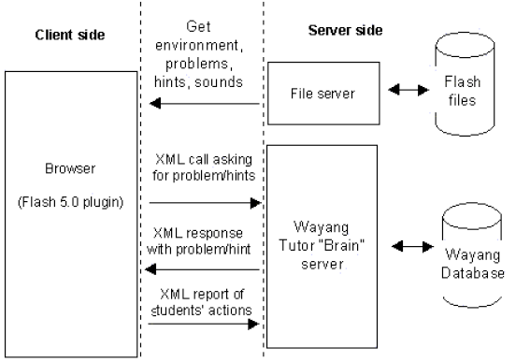
Wayang Outpost Architecture
Source:
I. Arroyo et al. “Wayang Outpost: Intelligent Tutoring for High Stakes Achievement Tests”
Notes:
Logging goes in a centralized database.
Tutor is Java-based. Interaction between them is solved via XML calls.
Wayang Tutor “Brain” server: database-backed Java servlet

Slide 8
Wayang Outpost Architecture
Logging of performance data
  Latency
  Answer choice
  Hints requested
Stored in centralized database

Slide 9
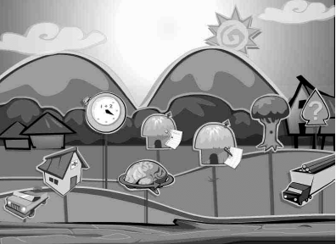
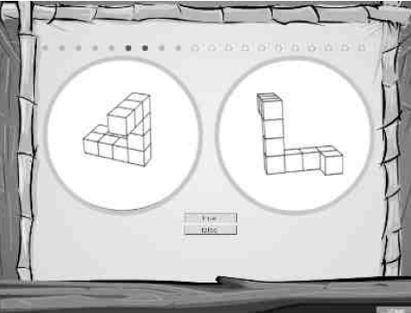
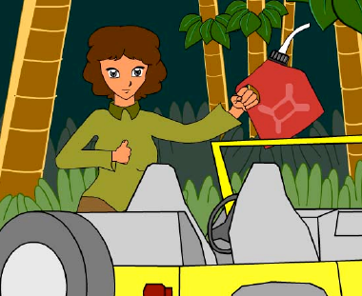
Wayang Outpost Interface
Source:
I. Arroyo et al. “Wayang Outpost: Intelligent Tutoring for High Stakes Achievement Tests”
Notes:
Top left: The Wayang Village showing buttons for different student modules, including the SAT hut, adventures, spatial skills test and the math fact retrieval test
Top right: Assessing the student’s spatial abilities through a standard mental rotation test.
Bottom left: Anne Russon leads the student to save oraguntans. “We need to find the shortest route and estimate how much extra gas we should take”. This is the fantasy component.

Slide 10
The experiment
SAT
MCAS
Control Group
88 students
Tutor Control Group
Interventions Group
2 mathematics tests of 43 items
Tutoring System “Wayang Outpost”
Notes:
SAT (Scholastic Aptitude Test) = test at the end of high school in the US
MCAS = high stakes, statewide-standardized achievement test exam
Only the “math-part” was taken into account. Tests usually contain also other fields.

Slide 11
Remarks on forming groups
Students after logon pseudo-randomly assigned to
Tutor Control
  Traditional Wayang: Possibility to click on help button which provides multimedia hints
Experimental (Interventions)
  Receiving intervention screens at fixed intervals of 6 problems
  Interventions: Performance graph with message or a tip that suggests a productive learning behavior
  Type of intervention was randomly-made decision
Notes:
Type of intervention randomly-made decision: Performance graph OR tip (and which one)

Slide 12
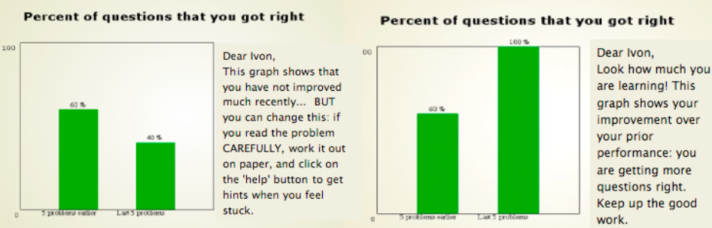
Performance Graphs
5 problems
earlier
Last 5 problems
5 problems
earlier
Last 5 problems
Notes:
Performance Graphs (Progress Charts) that show students their accuracy of responses from before to recently
DISADVANTAGE at the moment: very simple, possibly inaccurate

Slide 13
Type of tips
Tip-read-carefully
Read problem
Problem too hard?
Ask for hint and read it carefully
Hint introduces
something new?
Write down new information

Slide 14
Type of tips
Tip-make-guess
Think about problem and make a guess
Guess wrong?
Ask for hint
Need more hints?
Click on “help”

Slide 15
Type of tips
Tip-read-carefully
  Slow down
  Read problem carefully
  Read provided hints carefully
Tip-make-guess
  Think about the problem
  Make a guess
  If guess is wrong, ask for hints
Notes:
Of course, in this setting the students were not been able to use this tip already because they didn’t had the possibility to click the help button.

Slide 16
Procedure
4 test days
Pre-tests and post-tests counterbalanced
Post-tutor survey questions asked
Pretest
Tutoring
Posttest
day #1
day #2
day #3
day #4
Notes:
Pre-tests and post-tests completed online

Slide 17
AN(C)OVA
ANOVA (analysis of variance)
  Collection of statistical models
ANCOVA (analysis of covariance)
  Find dependencies between two (ore more) variables
significant difference at p<0.05
Notes:
BEFORE WE GO ON WITH THE TEST RESULTS...
Both models assume that the dependent variable is normally distributed.
ANOVA: Observed variance is partitioned into components due to different explanatory variables.
ANCOVA: Merger of ANOVA and regression for continuous variables.
In statistics, regression analysis is a technique which examines the relation of a dependent variable (response variable) to specified independent variables (explanatory variables).
p: probability of error

Slide 18
Test results
Group | Math Pretest | Math Posttest | MCAS Passing Rate
No Tutor
Tutor Control
Tutor Intervention
Group | Math Pretest | Math Posttest | MCAS Passing Rate
No Tutor |  |  | 76%
Tutor Control | 40% (20) | 40% (28) | 79%
Tutor Intervention | 33% (19) | 42% (22) | 92%
Survey question item | Tutor Interventions | Tutor Control
“The Wayang Tutor is friendly”
“The Wayang Tutor is smart”
Learning Orientation (average over 2 items)
Did you learn how to tackle math problems by using the Wayang system?
Helpfulness of the help (avg over 3 items)
Survey question item | Tutor Interventions | Tutor Control
“The Wayang Tutor is friendly” | 4.8 (1.0) | 3.9 (1.4)
“The Wayang Tutor is smart” | 5.1 (1.0) | 4.3 (1.3)
Learning Orientation (average over 2 items) | 0.60 (0.8) | 0.39 (0.6)
Did you learn how to tackle math problems by using the Wayang system? | 3.5 (0.74) | 3.1 (0.82)
Helpfulness of the help (avg over 3 items) | 4.2 (0.73) | 3.8 (0.90)
Notes:
Table 1: Means and standard deviations in performance measures before and after tutoring
Table 1 shows a “between-subjects” analysis, which means that the groups are compared with respect to each other.
Table 2: Means and standard deviations for responses to post-tutor surveys
Learning orientation scores in two items measure performance vs. learning orientation.
No significant differences for questions like ‘the tutor is concerned about my learning’ or self-efficacy
ANCOVA used to analyze the difference between the learning gains between the two groups

Slide 19
Test results
Notes:
Shows a “between-subjects” analysis, which means that the groups are compared with respect to each other.
ANCOVA used to analyze the difference between the learning gains between the two groups. Dependent variable was posttest score (percent correct), group as independent variable and pretest as a covariate.
Test of between subjects indicated a significant difference in posttest score between the tutor-control and tutor-interventions groups (F=4.23, p=0.04), suggesting that there is a significant difference in learning gains favoring the interventions-enhanced tutor group.

Slide 20
Test results
p = 0.01 in first two cases
Notes:
Y-axis: means for responses to post-tutor surveys
FORTH SURVEY QUESTION:
Did you learn how to tackle math problems by usings the Wayang system?

Slide 21
Time as engagement-indicator?
It’s a problem!
Short time period per problem = Disengaged?
  Students skip fast through the problems
  Students request help very quickly to get an answer to a question (help abuse)
  Student might be good
Long time period per problem = Engaged?
  Student might be off-task
  No investment of time results in no learning
  Insufficient but also necessary condition to learning!
Notes:
Can the level of engagement only be classified by using the time spent on a problem?
Students become more disengaged as time progresses, if tutor only presents problems: So the time spent on a problem is not enough to define the level of engagement!
Long time period:
Necessary: if student doesn’t invest time on the problem, they will surely not learn
Insufficient: student might be off-task (off-task = doing something that is not related to the problem; in contrast: on-task)

Slide 22
Effectiveness of interventions
Is there a difference in indicators of engagement from before to after the intervention was given?
There is!
Look at Median/Quartile statistics (with cropping outlier cases)
  Show engagement and focus on the problem
Notes:
Median/Quartile statistics instead of Means/Standard-deviations: one can look at the time spent per problem variable with some confidence that what one is looking at is engagement and focus on the problem

Slide 23
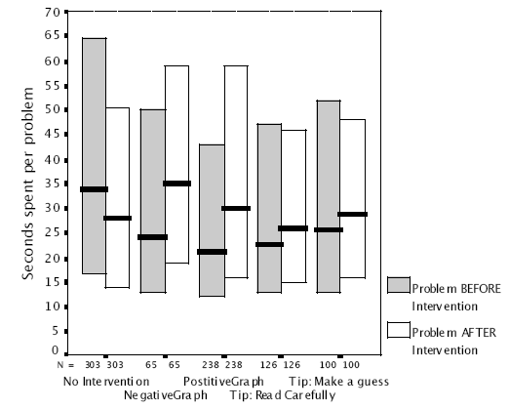
Median/Quartile statistics
Increase of median time spent in the problem after seeing any intervention.
Significant difference in time spent for Graphs (p = 0.004), but not for Tips
(p = 0.49)
N: number of random pairs of subsequent problems
Notes:
Left 2 quartiles: tutor control
Other quartiles: intervention
Students tend to get more disengaged as the session progresses (median and quartiles are lower in the second problem) → point to the first two quartiles
Bigger difference in median with negative or positive graph (→ SHOW ANIMATION)
In the paper: There is a significant difference for time spent from the problem before to the problem after a Graph Intervention, but not for before and after the tips.
MAIN QUESTION:
How do different interventions affect the time spent in a problem?
CLEARLY COMMUNICATE THE FOLLOWING ANSWER:
Graph Interventions have a higher impact on the time spent per problem and also a lower probability of quick-guesses
Can the level of engagement only be classified by using the time spent on a problem?
Students become more disengaged as time progresses, if tutor only presents problems: So the time spent on a problem is not enough to define the level of engagement!
Long time period:
Necessary: if student doesn’t invest time on the problem, they will surely not learn
Insufficient: student might be off-task (off-task = doing something that is not related to the problem; in contrast: on-task)

Slide 24
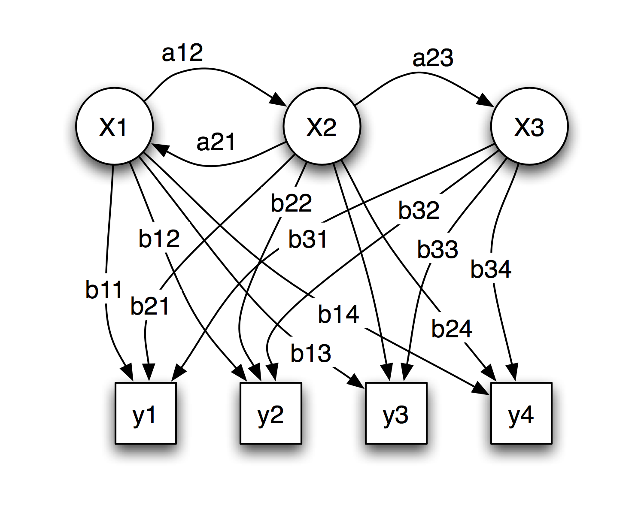
Hidden Markov Models
x: states
y: possible observations
a: state transition
probabilities
b: output probabilities
Source: http://en.wikipedia.org/wiki/Hidden_markov_model

Slide 25
Hidden Markov Models
0.7
0.3
0.6
Rainy
Sunny
0.6
0.4
0.4
0.5
0.6
0.1
0.4
0.3
0.1
P(clean | Rainy) = 0.5
walk
shop
clean
Adapted from: http://en.wikipedia.org/wiki/Hidden_markov_model
Notes:
Upper part: states with state transition probabilities
Lower part: possible observations with output probabilities
Assume you have a friend who lives far away and to whom you talk daily over the telephone about what he did that day. Your friend is only interested in three activities: walking in the park, shopping, and cleaning his apartment. The choice of what to do is determined exclusively by the weather on a given day. You have no definite information about the weather where your friend lives, but you know general trends. Based on what he tells you he did each day, you try to guess what the weather must have been like.
You believe that the weather operates as a discrete Markov chain. There are two states, "Rainy" and "Sunny", but you cannot observe them directly, that is, they are hidden from you. On each day, there is a certain chance that your friend will perform one of the following activities, depending on the weather: "walk", "shop", or "clean". Since your friend tells you about his activities, those are the observations. The entire system is that of a hidden Markov model (HMM).

Slide 26
Hidden Markov Models
0.7
0.3
0.6
Rainy
Sunny
0.6
0.4
0.4
0.5
0.6
0.1
0.4
0.3
0.1
P(clean | Rainy) = 0.5
walk
shop
clean
Adapted from: http://en.wikipedia.org/wiki/Hidden_markov_model
Notes:
Upper part: states with state transition probabilities
Lower part: possible observations with output probabilities
Assume you have a friend who lives far away and to whom you talk daily over the telephone about what he did that day. Your friend is only interested in three activities: walking in the park, shopping, and cleaning his apartment. The choice of what to do is determined exclusively by the weather on a given day. You have no definite information about the weather where your friend lives, but you know general trends. Based on what he tells you he did each day, you try to guess what the weather must have been like.
You believe that the weather operates as a discrete Markov chain. There are two states, "Rainy" and "Sunny", but you cannot observe them directly, that is, they are hidden from you. On each day, there is a certain chance that your friend will perform one of the following activities, depending on the weather: "walk", "shop", or "clean". Since your friend tells you about his activities, those are the observations. The entire system is that of a hidden Markov model (HMM).

Slide 27
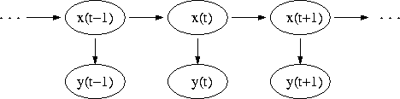
Hidden Markov Models
x(t): hidden state at time t
y(t): observation at time t
Source: http://en.wikipedia.org/wiki/Hidden_markov_model
Notes:
x(t) only depends on x(t-1)
y(t) only depends on x(t)
Arrows denote conditional dependencies

Slide 28
Item Response Theory
Evaluate student’s proficiency
Allows to calculate conditional standard errors of measurement
  based on a test information function
  not assuming an average standard error across all trait levels
Further Applications
  developing and refining exams, equating for difficulties of successive versions of exams
Sources: http://work.psych.uiuc.edu/irt/intro_main.asp
http://en.wikipedia.org/wiki/Item_response_theory
Notes:
The standard error of a method of measurement is the estimated standard deviation of the error in that method.

Slide 29
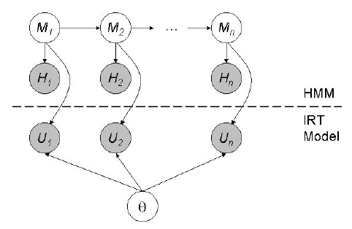
Dynamic Mixture Model-IRT
DMM-IRT = IRT + HMM
i: current problem
M_{i}: motivation
H_{i}: evidence of motivation
U_{i}: (initial) response of user
θ: proficiency
Notes:
H_{i}: evidence corresponding to hidden motivation variable (takes as many values as the motivation variable). This variable is defined using the number of hint requests and time spent.
U_{i}: if a student’s initial response is to ask for a hint, U_{i} is labeled as incorrect
IRT to gauge/assess student proficiency
HMM to infer a student’s motivation
First-order Markov assumption holds: M_{i+1} only depends on M_{i}

Slide 30
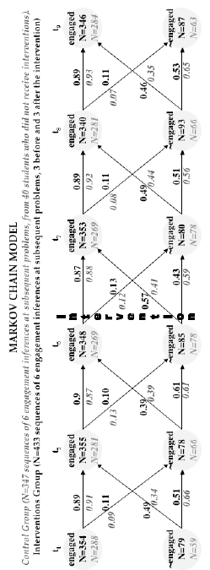
Engaged or not engaged, that is the question...
P(E_{t5}|~E_{t4}) = 0.49
N: number of students
Notes:
“Control Group” means here “Tutor Control Group”
The HMM infers the probability that a student is in any of the states ‘engaged’, ‘quick-guess’, ‘hint-abuse’ or ‘skipped-problem’ for each problem, depending on their behavior on the current problem and the motivation state in the previous time step. The student is classified as engaged/disengaged based on the engagement state of the highest likelihood.
Re-engagement probabilities are higher for the Interventions Group
COLORED CIRCLES:
Students in Interventions Group oscillated more between engaged and disengaged states;
Probabilities of disengagement and re-engagement are generally higher than the control group
ORANGE CIRCLES:
Students in the interventions group are also more likely to disengage by a small margin.
Engagement status is hard to maintain.
Interventions only have a short-term impact on engagement.
Exposing students who are already engaged to an intervention might be unproductive.
KEYWORDS:
Finding the most likely sequence

Slide 31
Engaged or not engaged, that is the question...
P(E_{t5}|~E_{t4}) = 0.49
N: number of students
Notes:
“Control Group” means here “Tutor Control Group”
The HMM infers the probability that a student is in any of the states ‘engaged’, ‘quick-guess’, ‘hint-abuse’ or ‘skipped-problem’ for each problem, depending on their behavior on the current problem and the motivation state in the previous time step. The student is classified as engaged/disengaged based on the engagement state of the highest likelihood.
Re-engagement probabilities are higher for the Interventions Group
Interventions only have a short-term impact on engagement.
Exposing students who are already engaged to an intervention might be unproductive.
KEYWORDS:
Finding the most likely sequence

Slide 32
Is this model appropriate?
What was done?
  Inference of the probability that a student is in a any of the states ‘engaged’, ‘quick-guess’, ‘hint-abuse’ or ‘skipped-problem’
  Model to present and process collected data
  Based on that: calculation of transition probabilities
What is missing in the Markov Chain?
  Type of intervention (Progress Graph or Tip)
Notes:
The HMM infers the probability that a student is in any of the states ‘engaged’, ‘quick-guess’, ‘hint-abuse’ or ‘skipped-problem’ for each problem, depending on their behavior on the current problem and the motivation state in the previous time step. The student is classified as engaged/disengaged based on the engagement state of the highest likelihood.

Slide 33
Probability of a student being disengaged
 | t₄ | t₅ | t₆ |  | t₇ | t₈ | t₉
Interventions | 0.18 | 0.18 | 0.20 |  | 0.18 | 0.21 | 0.20
Control | 0.17 | 0.19 | 0.22 |  | 0.22 | 0.19 | 0.18
Difference | 0.01 | -0.01 | -0.02 |  | -0.04 | 0.02 | 0.02
Notes:
Probability of a student being disengaged. Hardly any difference in probabilities.

Slide 34
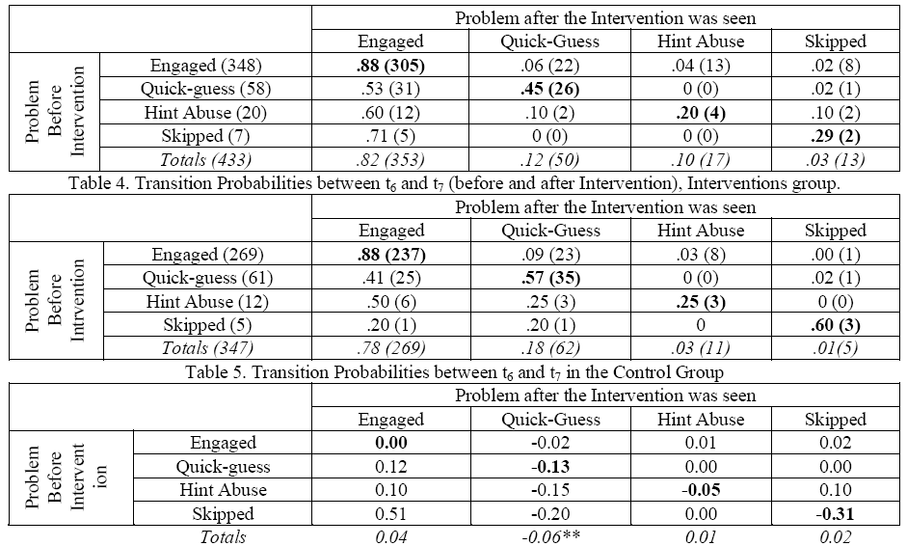
Notes:
Table 6: difference between the previous matrices. Positive values indicate that the probability is higher for the motivational group, negative values indicate the opposite.
Table 6 (bold diagonal) shows that students in the interventions group are less prone to stay in the same disengagement state.

Slide 35
Summary
The “winner”: Interventions group.

Slide 36
Summary
The “winner”: Interventions group. Why?
  Lower pre-test scores, but higher post-test scores
  Higher passing rates in standardized tests
  Higher learning-orientation in post-tutor survey
  Feeling, that tutor was more helpful, they learned more, they attributed more human-like characteristics to tutoring software
  Higher chance becoming re-engaged after seeing an intervention
So what?

Slide 37
Conclusions
Present non-invasive interventions
  help students reflect on their progress
Research results provide valuable insight in
  support of in-between problem meta-cognitive feedback
How to use this knowledge?

Slide 38
Performance Graphs
Approximated by the “progress bars” on the left and on the top
Notes:
“Progress bars” do not show the performance, but show a complete overview what topics are known and what topics are not.
Comparing percentage correct responses in the last problems is not an accurate enough measure to assess how much students know. Following better...

Slide 39
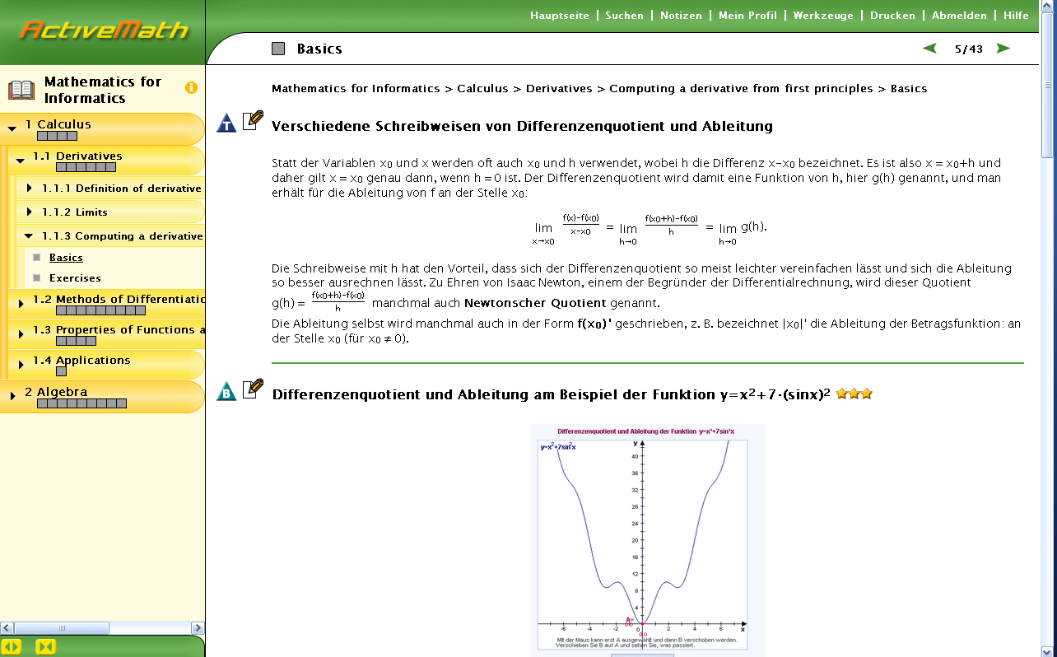
Performance Graphs
Notes:
PRO of this design: One can get overview of own knowledge; whole progress is depicted.
CONTRA of this design: Do not see actual performance in previous tasks.

Slide 40
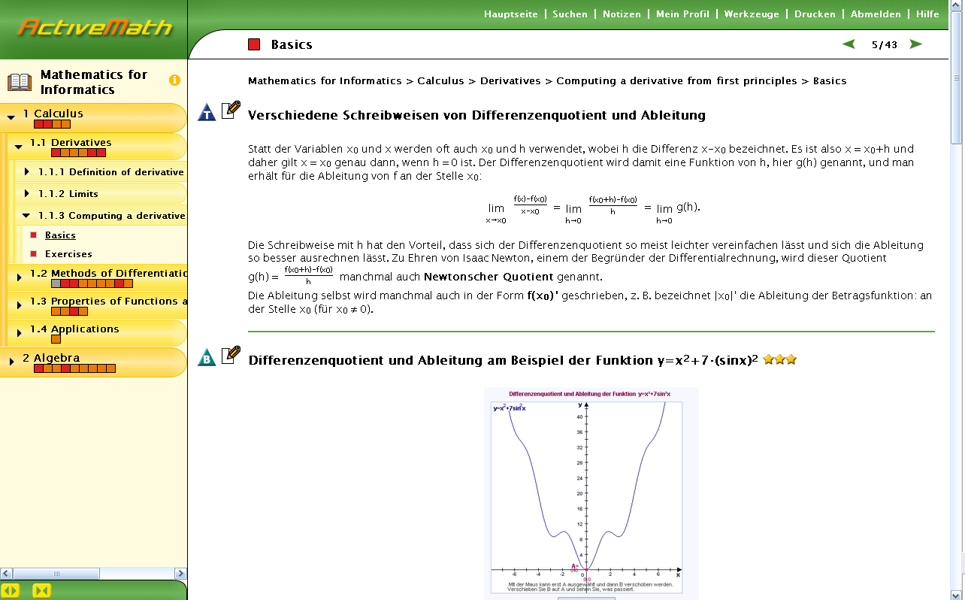
Performance Graphs

Slide 41
When to provide interventions?
Always?
  Good overview possible, but annoying
  What about engaged students?
After a fixed amount of problems?
  What about engaged students?
Adapted to the student’s engagement state?
  Seems to be a good solution

Slide 42
Which interventions to show?
Performance Graphs
  As in the experiment
  As in ActiveMath
  As in the experiment with additional feedback on how the own performance is in comparison to the other users
New meta-cognitive feedback
  Specific feedback on planning how to solve a specific kind of problem
Notes:
“progress bars” similar to ActiveMath

Slide 43
Improve hints
Don’t give the same hint again and again
  Try to explain from another viewpoint
Provide individual hints
  User’s profile as basis
Supplementary exercises
  Good, if hints do not help anymore
Notes:
Easy example concerning “individual hints”: computer science people count beginning with 0 where mathematics people start with 1.

Slide 44
Type of student?
Classify students, f. ex. with the following states
  engaged
  quick-guess
  hint-abuse
  skipped-problem
To predict the type of student at t_{i+1}:
  Use Hidden Markov Model
What type of student do we have at time-step t_{i}?
  Use Decision Tree
  Compare with predicted result from t_{i-1}
}
disengaged
Notes:
At the end, one can check whether the predicted state by the HMM is equal to the actual state observed using the DT.
Comparison of the result: Improvement of predictions possible, because a mis-prediction cannot be easily propagated

Slide 45
DT for student classification
Tried to solve?
Yes
No
time < T
skipped-problem
Yes
No
Solution right?
Got hint?
Yes
No
Yes
No
engaged
quick-guess
Abused?
engaged
Yes
No
hint-abuse
engaged
Notes:
Just an example to get the idea. Maybe some sort of reorder might be clever.

Slide 46
Multimedia in ActiveMath?
Integration of multimedia
  Animations
  Sound (?)
Integration of an (intelligent) agent
  Like Microsoft Office Agent
  Showing different gestures (being angry, being impressed)
  → special type of hint, human-like attitude
Notes:
“Sound” depends on what topic is being taught. Maybe “Mathematics for Informatics” is not the right topic for the usage of sound. But take people from elementary school.

Slide 47
References
I. Arroyo et al. “Repairing Disengagement With Non-Invasive Interventions”
http://ccbit.cs.umass.edu/people/ivon/AIED2007.PDF
(Original paper on which the talk is based on)
I. Arroyo et al. “Wayang Outpost: Intelligent Tutoring for High Stakes Achievement Tests”
http://wayang.cs.umass.edu/wayang/Wayang-Final.pdf
(Paper on the Tutoring System Wayang Outpost)
B. M. McLaren et al. “The Help Tutor: Does Metacognitive Feedback Improve Students’ Help-Seeking Actions, Skills and Learning?”
http://www.pitt.edu/~bmclaren/HelpTutor-ITS2006.pdf
(Metacognitive feedback in an ITS to regulate help-seeking behavior)

Slide 48
References
R. Baker et al. “Adapting to When Students Game an Intelligent Tutoring System”
http://joazeirodebaker.net/ryan/Baker175.pdf
(Impact of gaming on students)
R. Baker et al. “Detecting Student Misuse of Intelligent Tutoring Systems”
http://joazeirodebaker.net/ryan/BCK2004MLFinal.pdf
(Ideas on how to detect gaming)
J. Johns et al. “A Dynamic Mixture Model to Detect Student Motivation and Proficiency”
http://www.cs.umass.edu/~johns/pubs/aaai06dmmirt.pdf
(Item Response Theory, DMM-IRT)

Slide 49
Thank you!

Slide 50
QUESTIONS?

